Slide 1
Quantum Convolutional Neural Network for Classical Data Classification
ADITYA SHRIVASTAVA

Slide 2

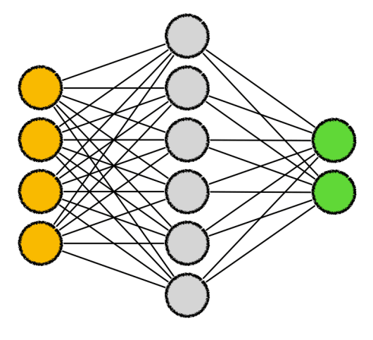
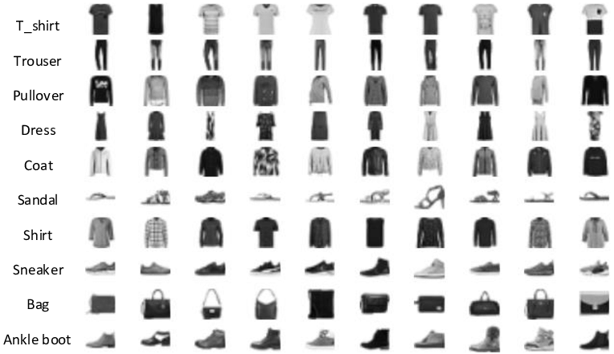
PROBLEM STATEMENT
Train a Quantum CNN on the classical Fashion MNIST dataset using different unitary parametrized gates as building blocks and test their accuracies

Slide 3
WORKING OF QCNNs
The above expression represents the quantum state resulting from the ith layer of the QCNN.
Applying a partial trace operator helps us in getting data from the subsystem that extracts relevant features.

Slide 4
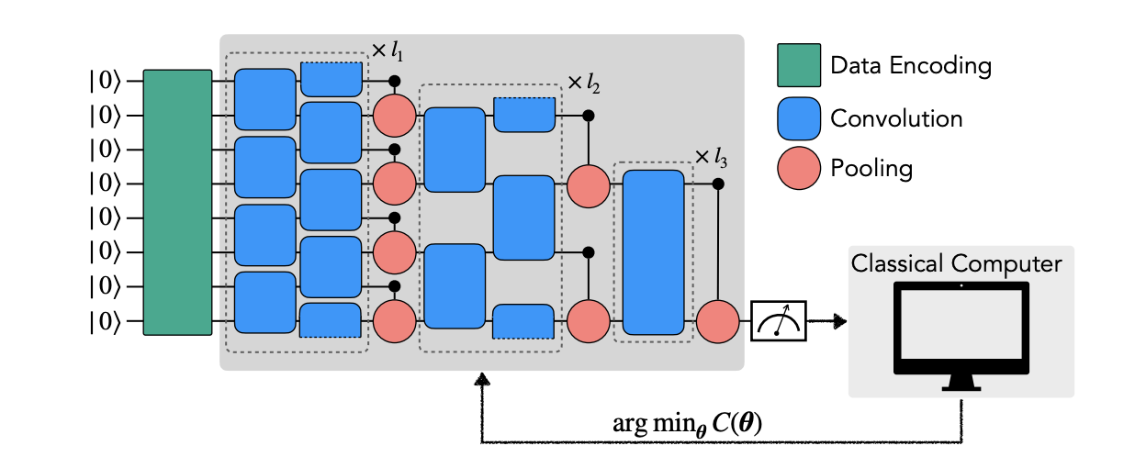
Training Architecture

Slide 5
Data Encoding Techniques
Amplitude Encoding
  Reduces no. of parameters doubly exponentially with increase in size
  Quantum circuit depth usually increase in the order of a polynomial of size
Qubit Encoding
  Maps one input data to one qubit
  Has a constant circuit depth
Hybrid Direct Encoding
  Makes blocks of data that are individually amplitude encoded
  Need to have similar amplitude normalization constants
Hybrid Angle Encoding
  Circumvents the problem of varying normalization constants

Slide 6
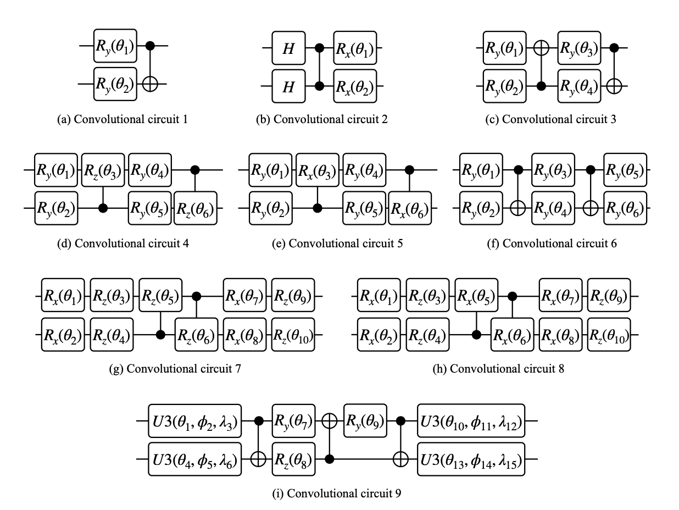
Convolutional Neural Network Layer
One type of ansatz is selected for all CNN layers.
Different CNN architectures are implemented and tested for their accuracy

Slide 7
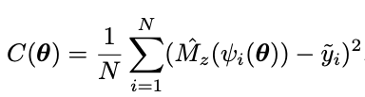
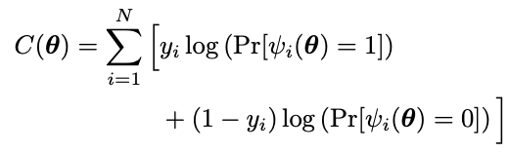
Cost Function
Mean Squared Loss
Cross Entropy Loss

Slide 8
Conclusion
References
Accuracy of upto 91% was achieved in the project experiment
QCNNs are able to achieve high accuracy even with exponentially less parameters
Leveraging entanglement QCNNs can find out global correlations compared to the local correlations found by classical CNNs
Performance of larger QCNN models on more real world centric use cases are significantly important and have to be analyzed
Quantum convolutional neural network for classical data classification - Tak Hur, Leeseok Kim, and Daniel K. Park
https://github.com/takh04/QCNN

Slide 9
THANK YOU!

